Slide 1
ELECTRONIC HEALTH RECORD SYSTEM

Slide 2
PRESENTERS:
Jan Russel E. Peñafiel
Jaspherjohn C. Amoguis
Elisha Byron Napoles

Slide 3
INTRODUCTION
An electronic health record (EHR) is a digital version of a patient’s paper chart. EHRs are real-time, patient-centered records that make information available instantly and securely to authorized users. While an EHR does contain the medical and treatment histories of patients, an EHR system is built to go beyond standard clinical data collected in a provider’s office and can be inclusive of a broader view of a patient’s care.

Slide 4
GENERAL OBJECTIVES
The study aims to manage personnel, students, consultations, treatments, medicine inventory, medical history, and online features for students and personnel. It includes online appointments, records, alerts, events, monitoring, online consultation, notifications, accounts, contacts, and reports. The study also includes a dashboard for students and personnel, generates reports, and evaluates the study's efficiency and informativeness.

Slide 5
OBJECTIVES
1. Admin
2. Online Registration or Sign up for students and personnels
3. Fill-up a form for students and personnels
4. Login/Logout
4. School Nurse manage the following :
4.1 Personnels Information
4.2 Students Information
4.3 Consultations Information
4.4 Treatments Information
4.5 Medicine Inventory
4.6 Medical History for Students

Slide 6
OBJECTIVES
5. Online Features
5.1 View Records for Consultation and Treatments
5.2 Online Appointment for students and personnels
5.3 Search Students with inserting and editing students information for Consultations and Treatments
5.4 View Alerts (High body temperature, High blood pressure) Alerts for specific students and personnels automatically send though Gmail
5.5 Events for students and personnels send through Gmail
5.6 Monitoring student condition (Temperature, Blood pressure)
5.7 Online Consultation (Chatbot)

Slide 7
OBJECTIVES
6. Notifications send event for students and personnels through Gmail
7. Accounts
8. Contacts
9. View Reports
10. Other Feature
10.1 Dashboard
10.2 Student Dashboard
10.3 Personnel Dashboard
11. Generate Reports
11.1 Number of Students
12. Evaluate the Study in terms of :
12.1 Efficiency
12.2 Informative

Slide 8
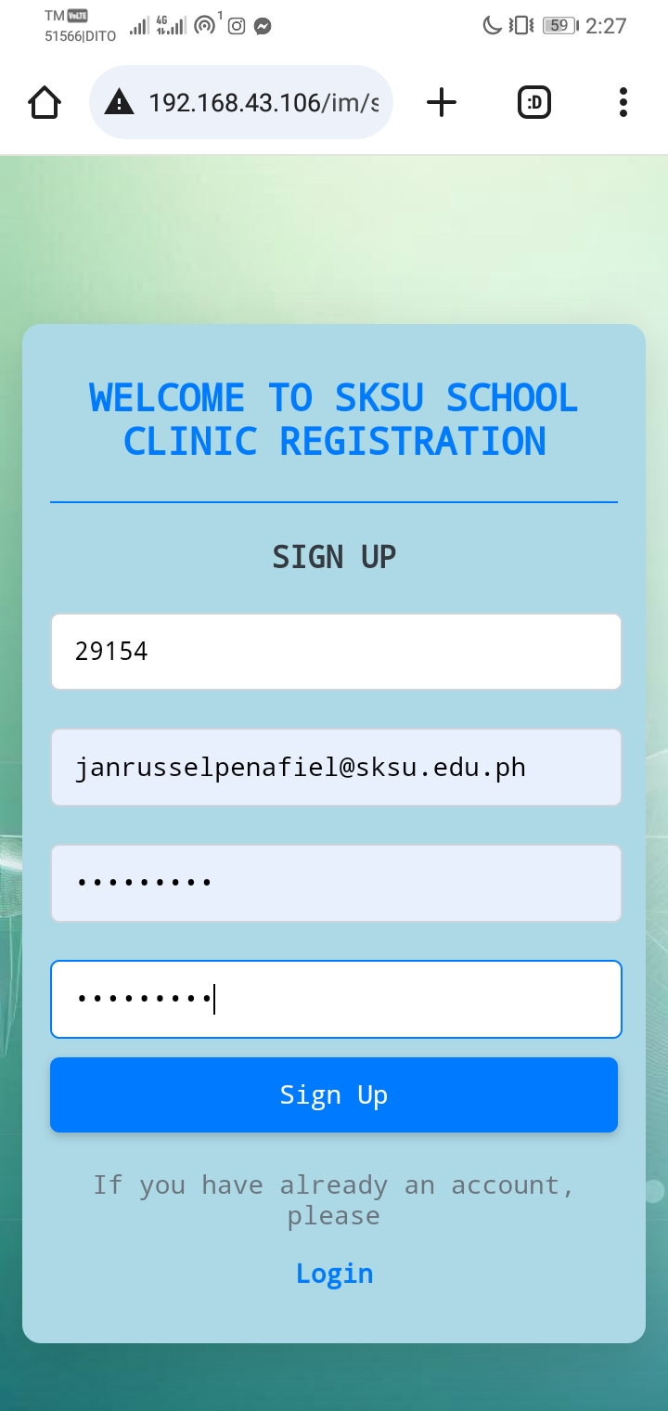
1. Online Registration (ID Number, SKSU Account , Password)

Slide 9
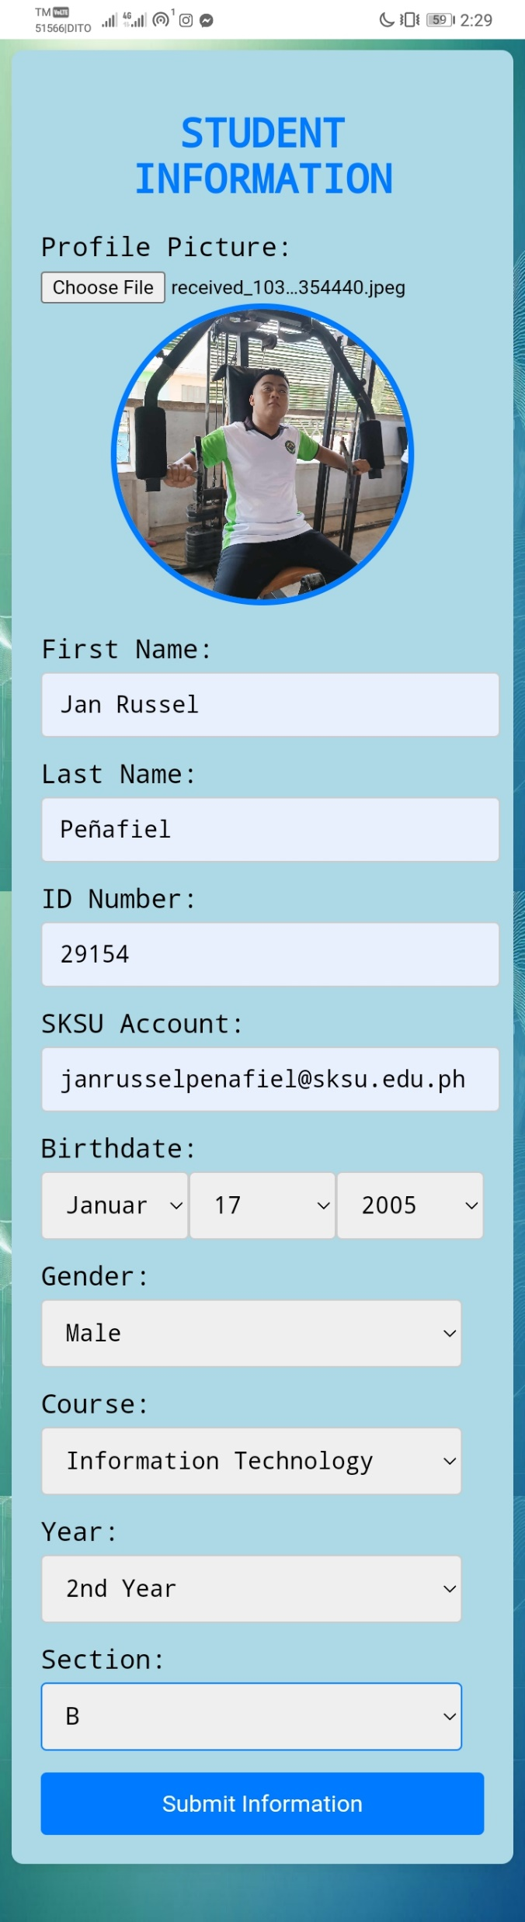
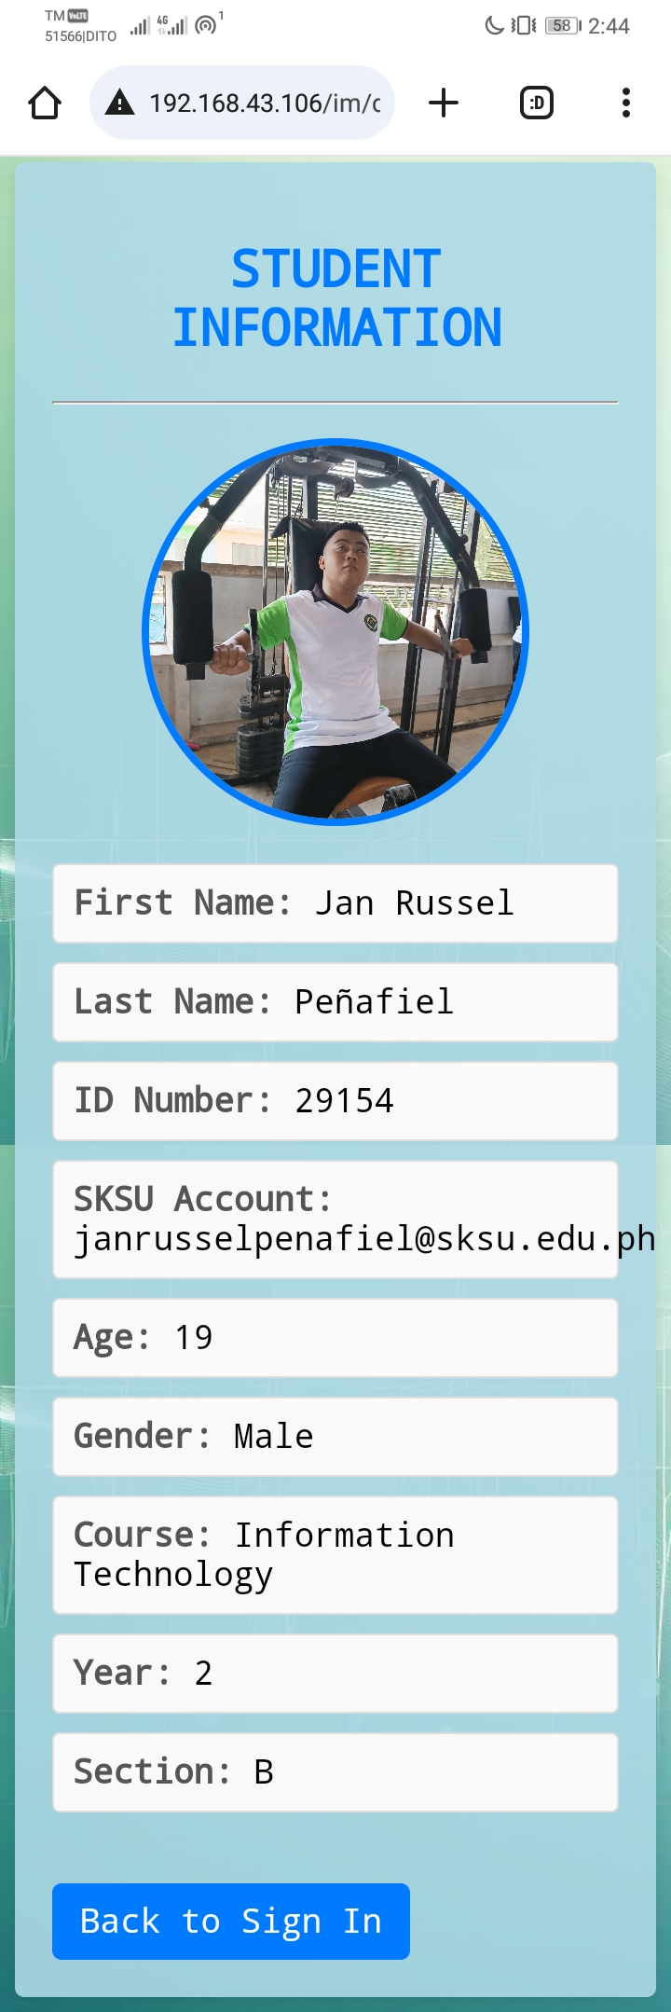
2. Fill-up a form (Full Name , ID Number ,Gmail Account, Age, Gender, Course, Year, Section)

Slide 10
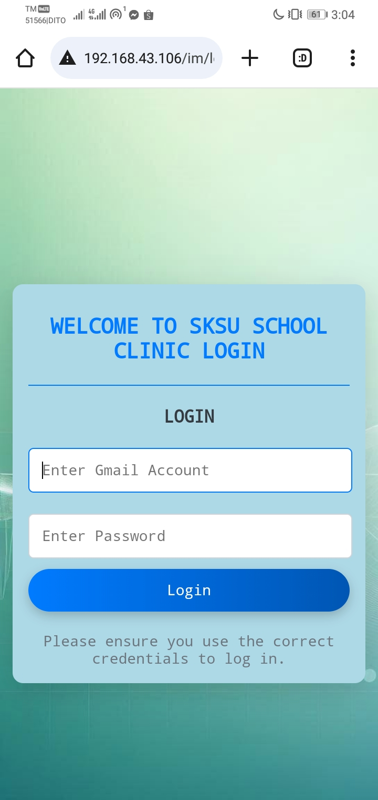
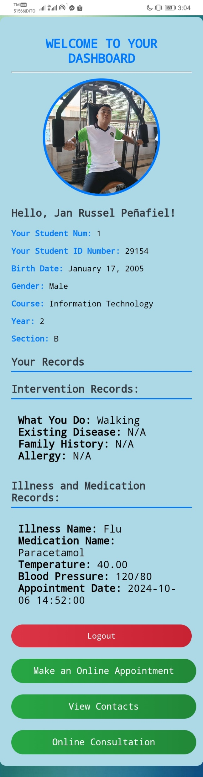
3. Login/Logout (ID Number, Gmail Account, Password)

Slide 11
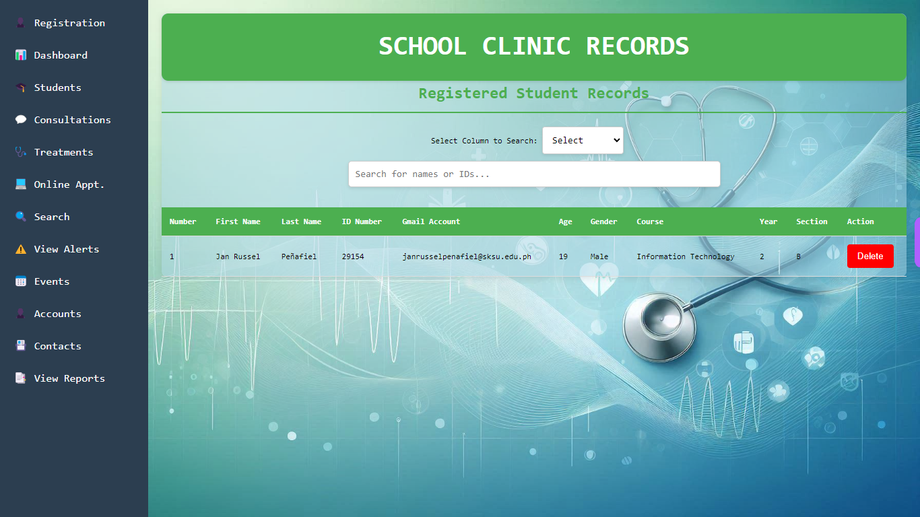
4. School Nurse manage the following :
4.1 Students Information (Full Name , ID Number ,Gmail Account, Age, Gender, Course, Year, Section)

Slide 12
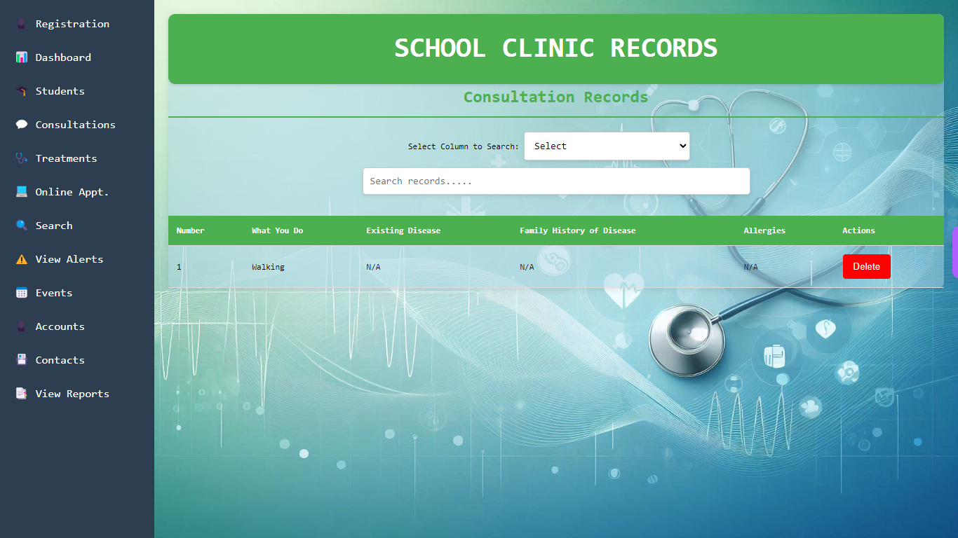
4.2 Consultations Information (What you do?, Existing disease, Family history disease, Allergies)

Slide 13

4.3 Treatments Information (Illness name, Medication name, Temperature, Blood Pressure , Appointment Date)

Slide 14
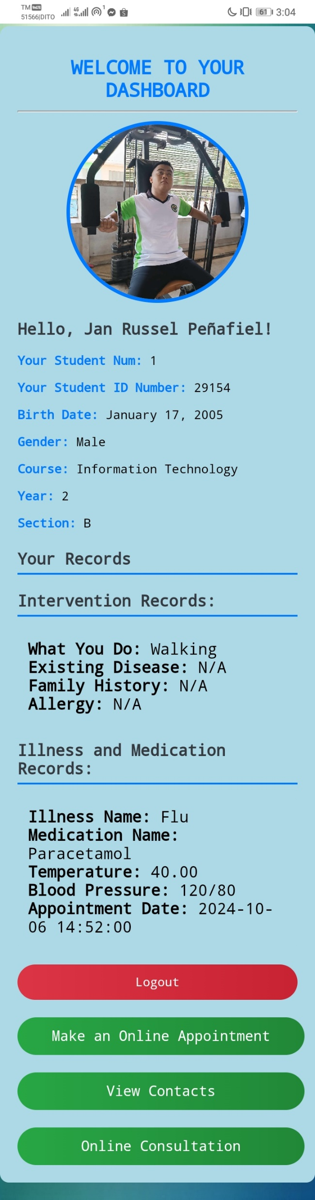
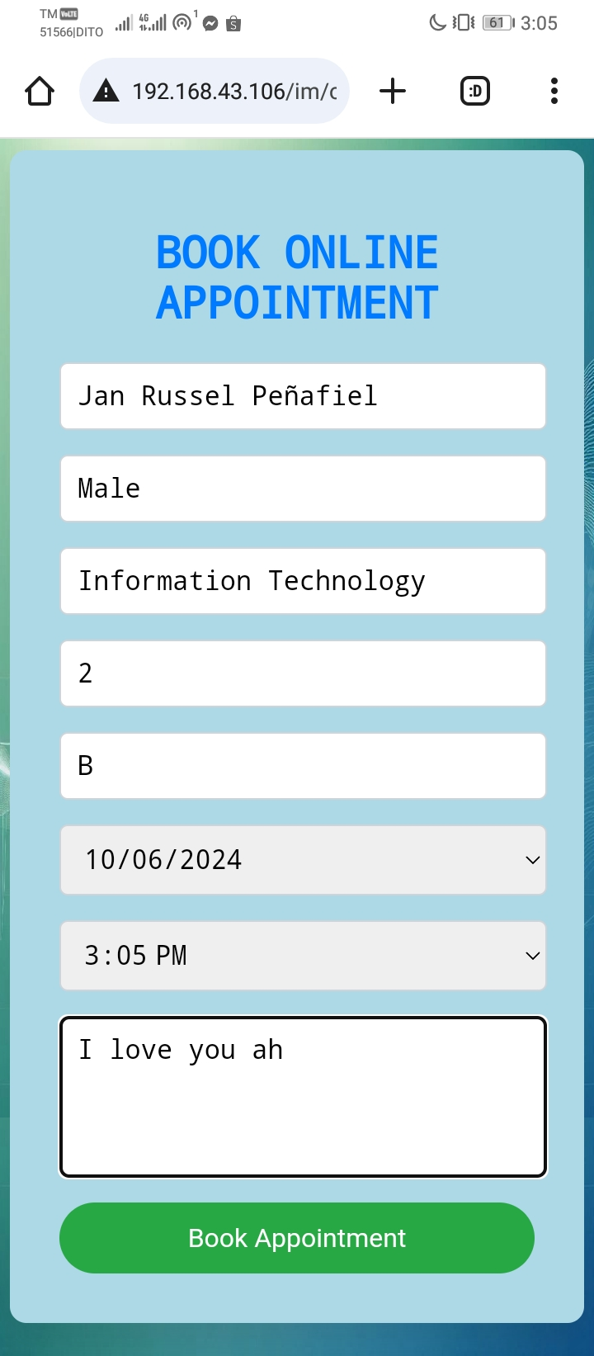
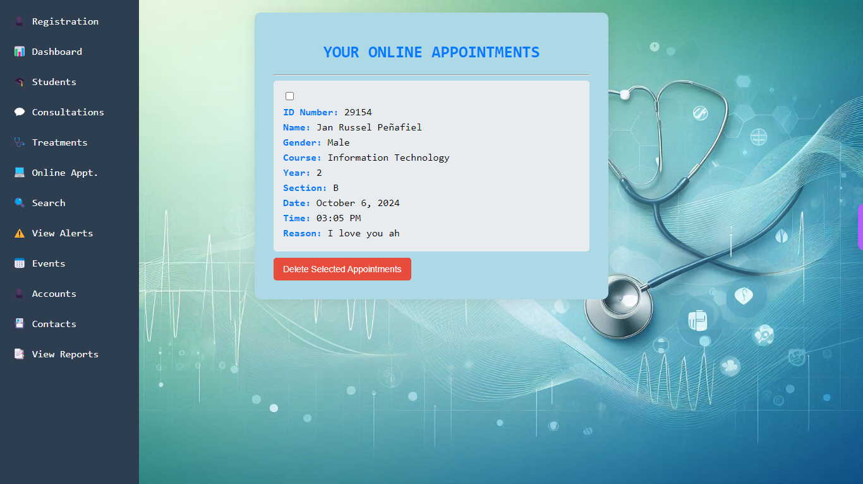
5. Online Features
5.1 Online Appointment

Slide 15
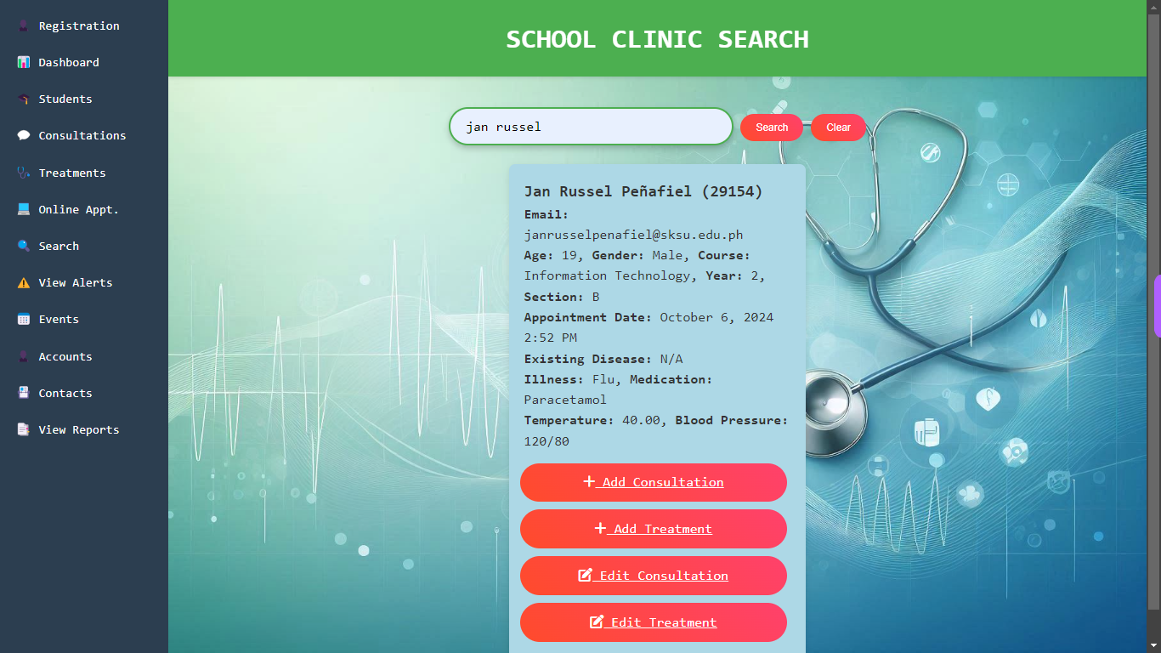
5.2 Search Students with inserting and editing information for Consultations and Treatments

Slide 16
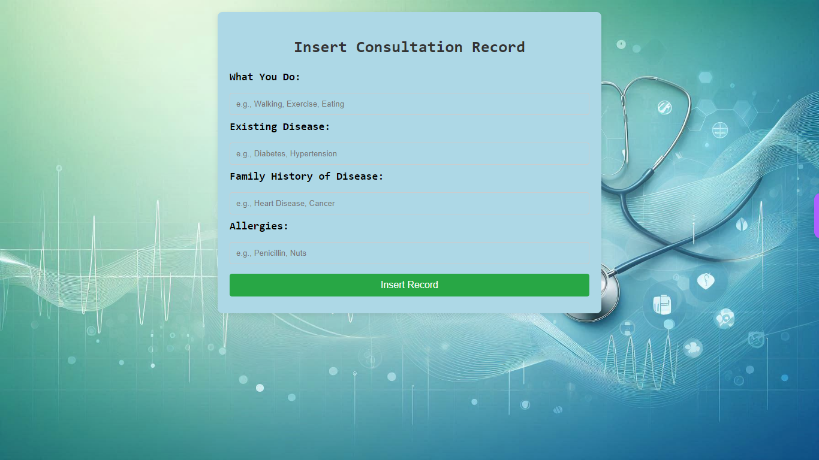
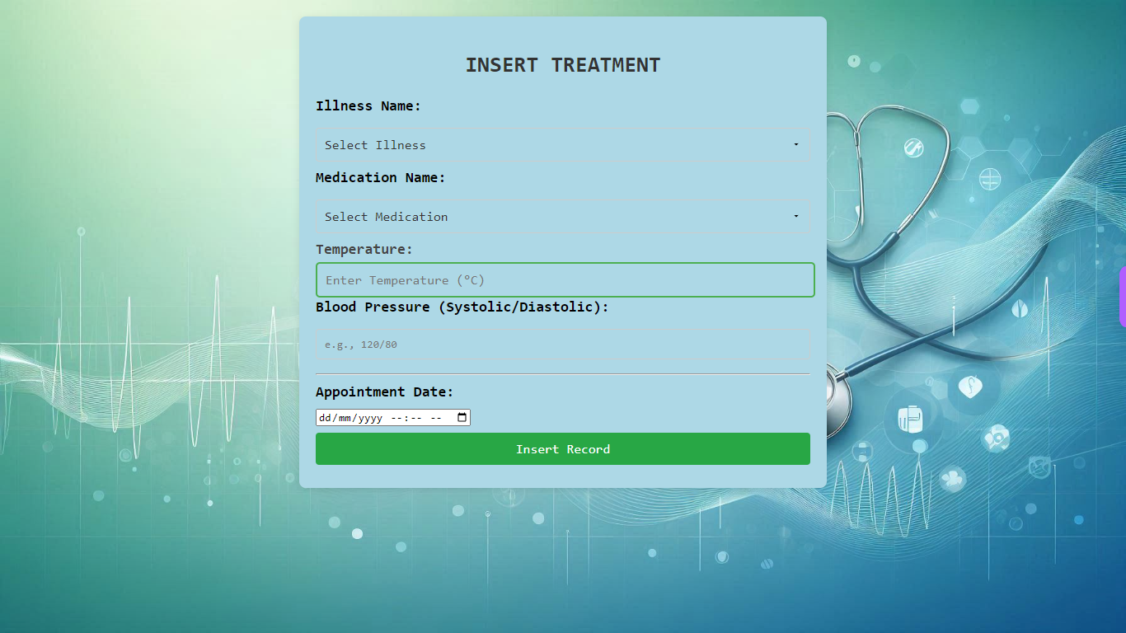
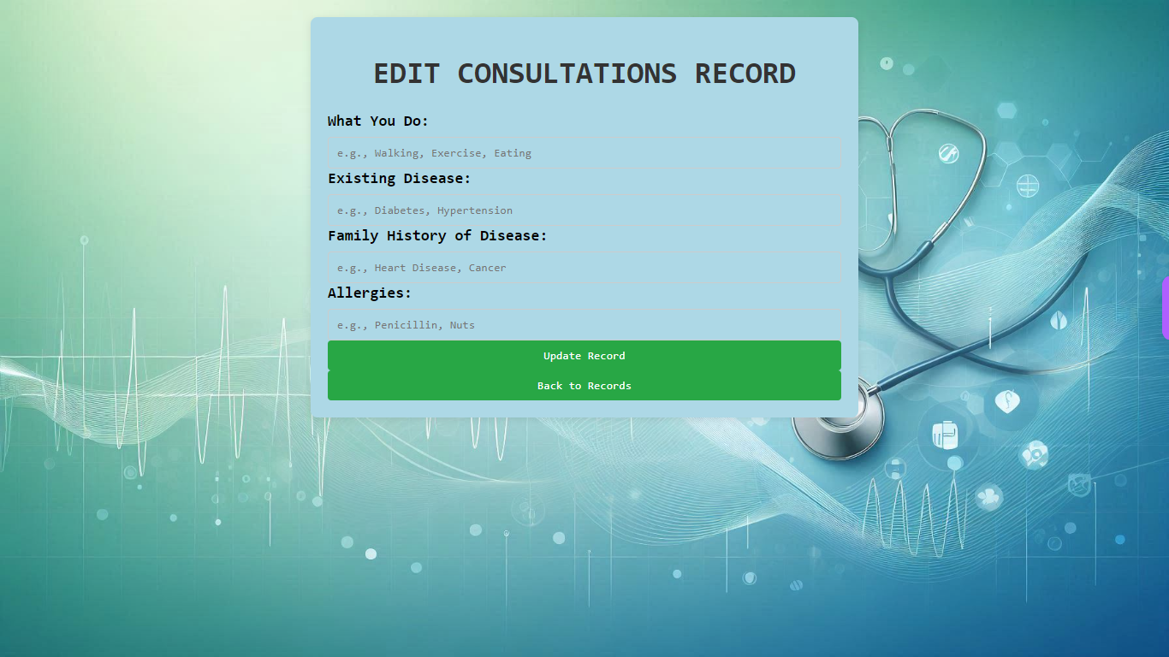
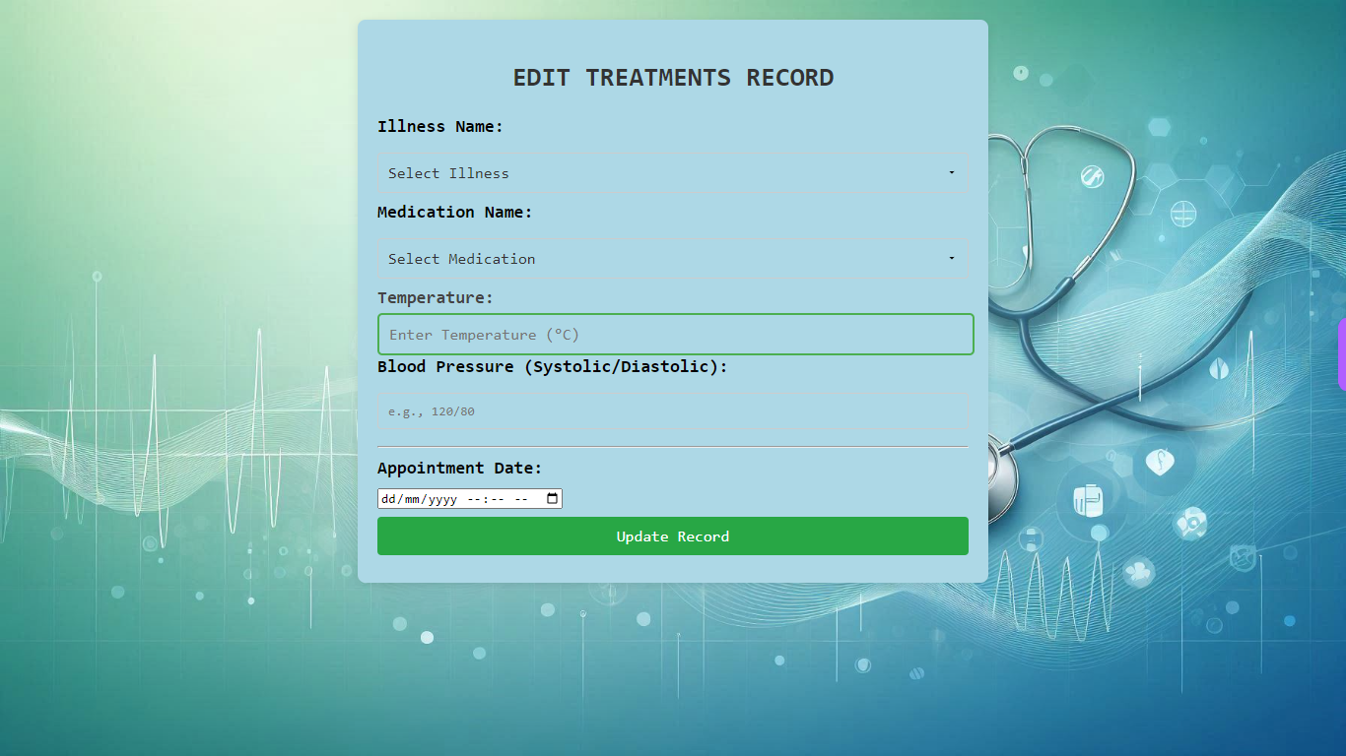
5.3 Search Students with inserting and editing information for Consultations and Treatments

Slide 17
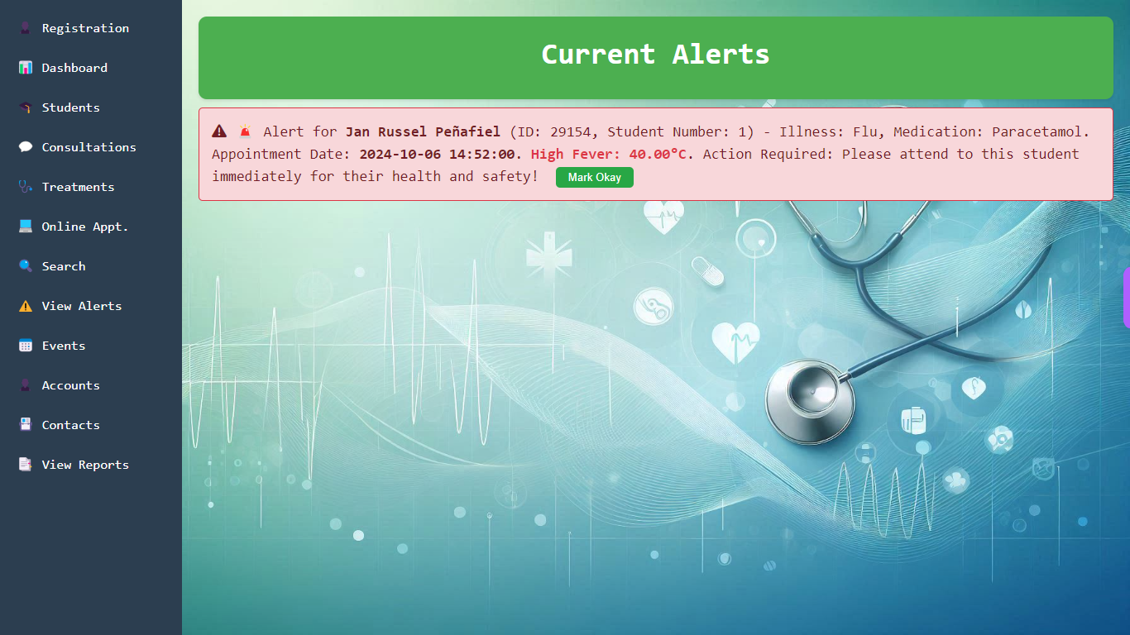
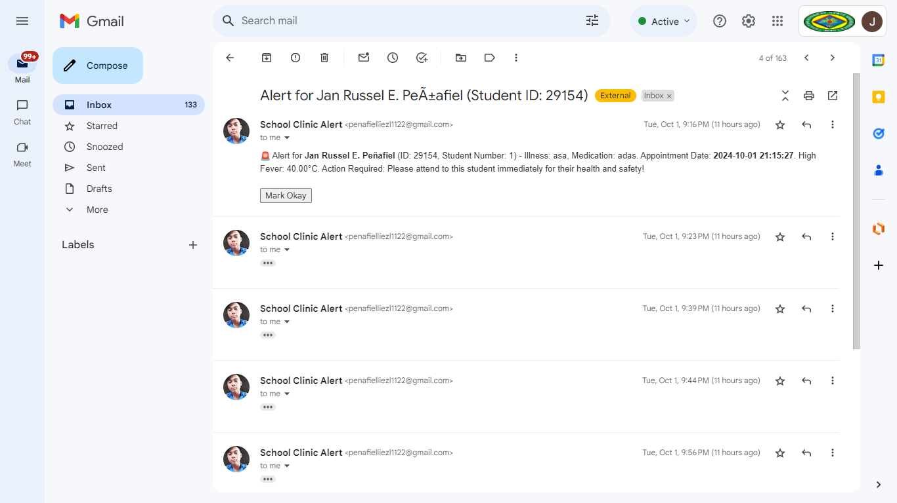
5.4 View Alerts (High body temperature, High blood pressure) Alerts for specific students automatically send though Gmail

Slide 18
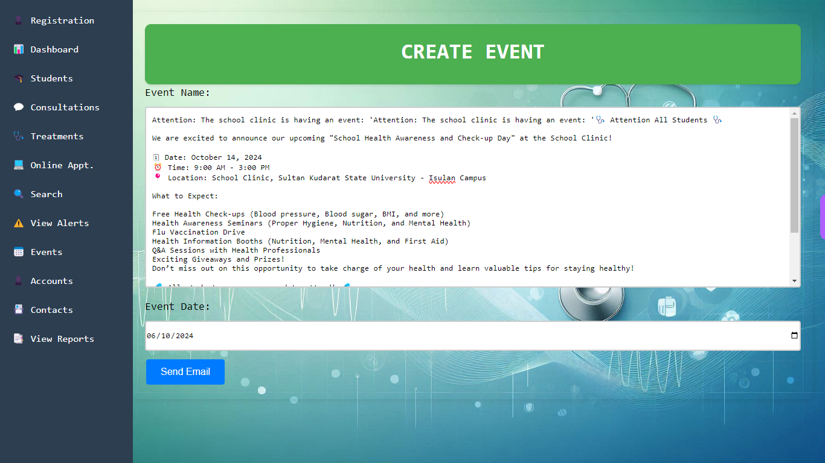
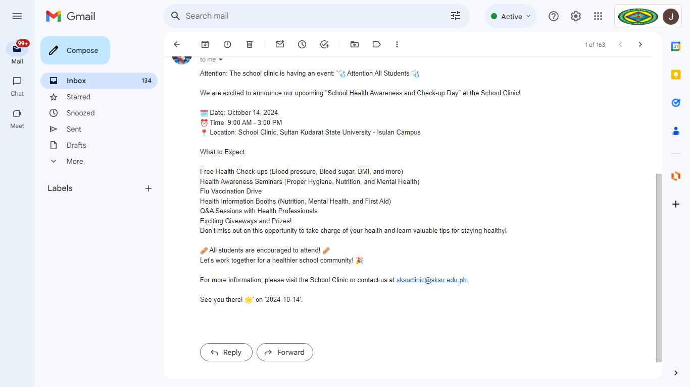
5.4 Events send through Gmail

Slide 19
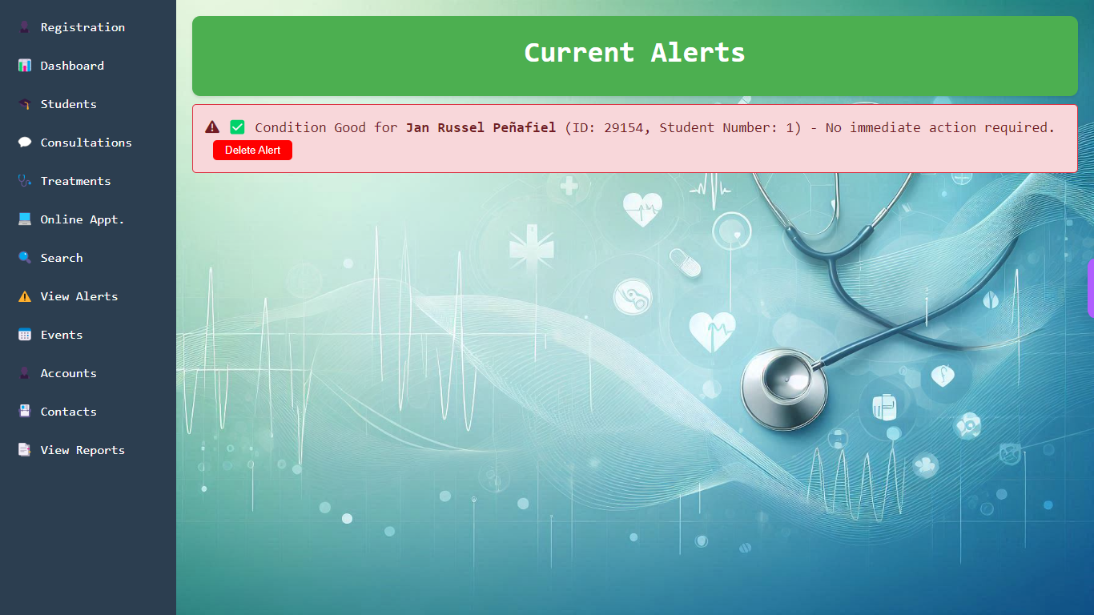

5.5 Monitoring student condition (Temperature, Blood pressure)

Slide 20
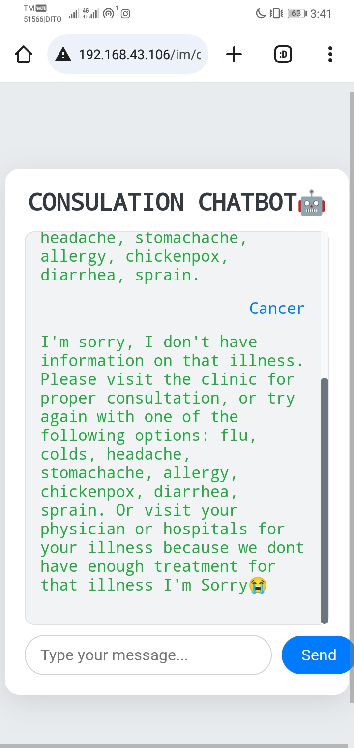
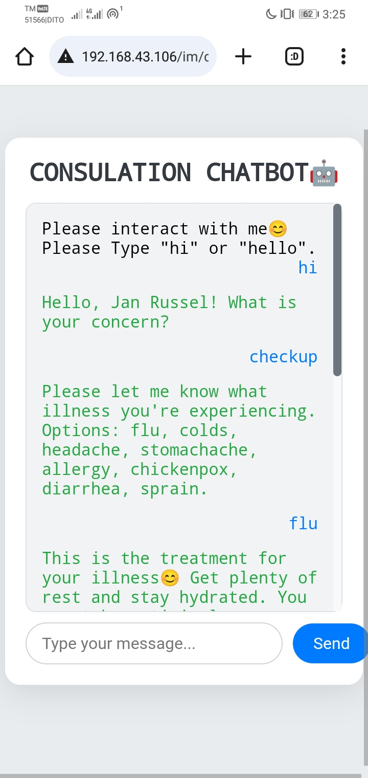
5.6 Online Consultation (ChatBot)

Slide 21
6. Notifications send event and alert of students through Gmail

Slide 22
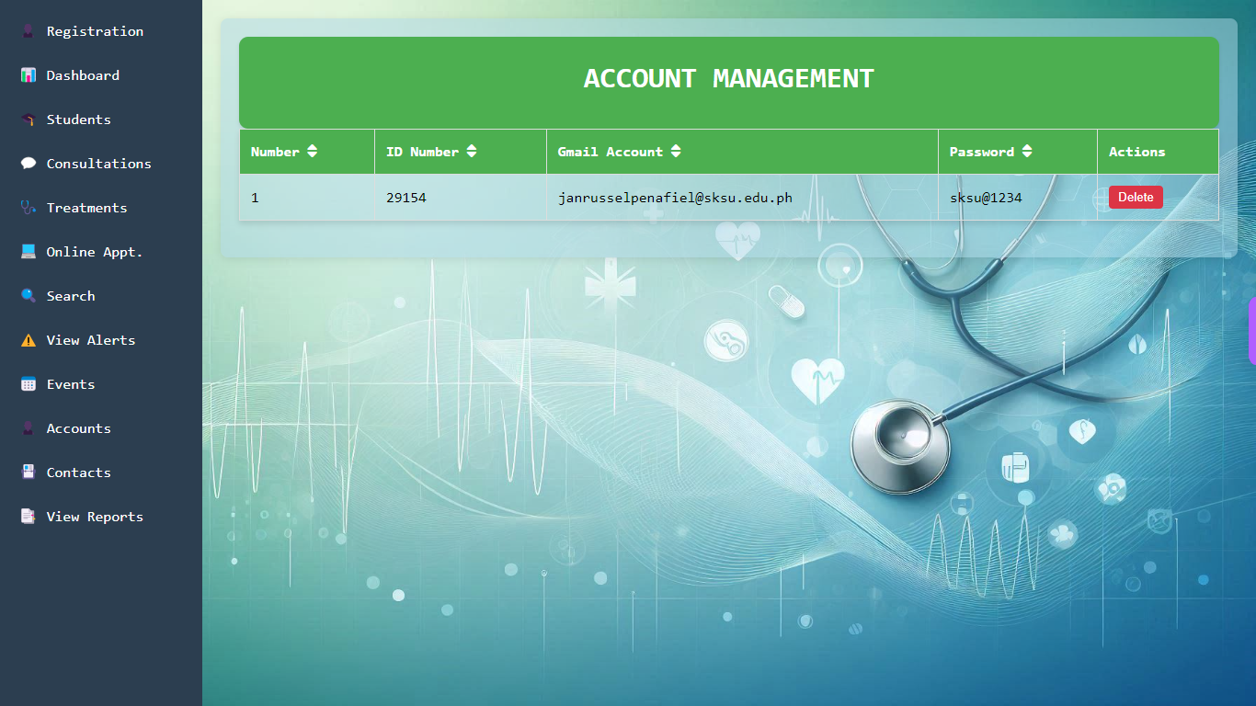
7. Accounts (ID Number, Gmail Account , Password)

Slide 23
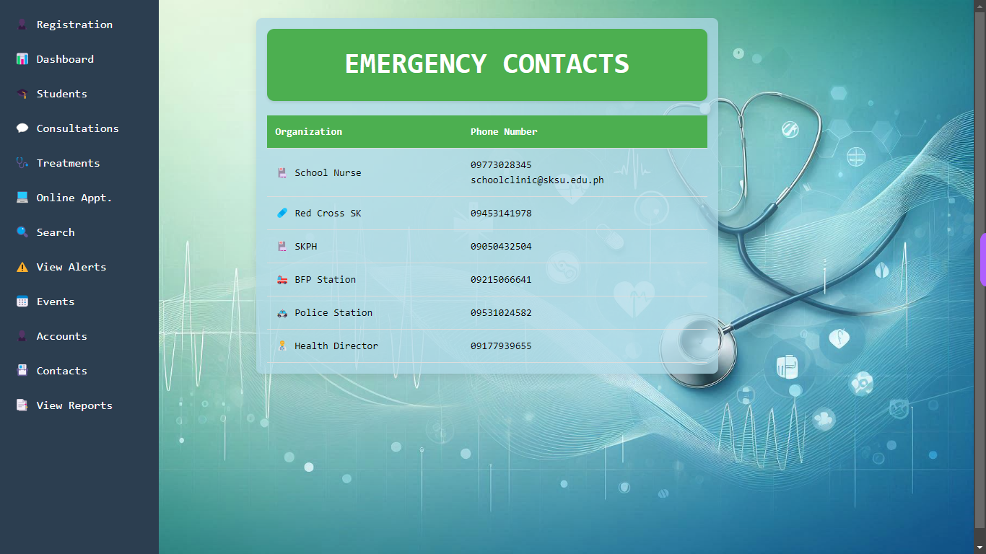
8. Contacts (Organization, Phone Number)

Slide 24
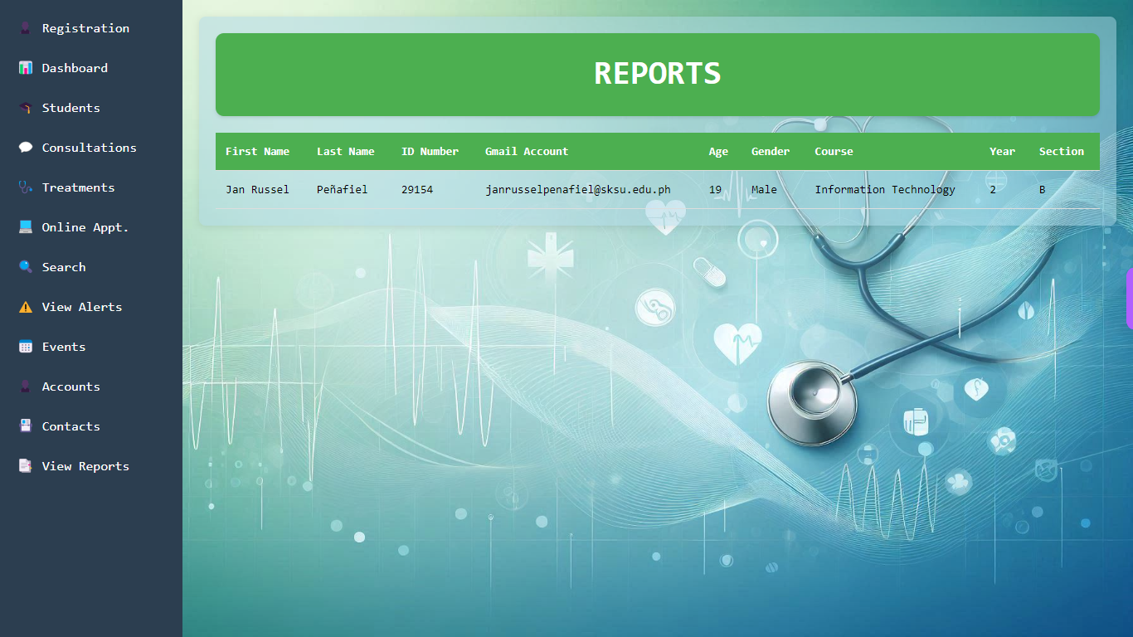
9. View Reports (Student Information)

Slide 25
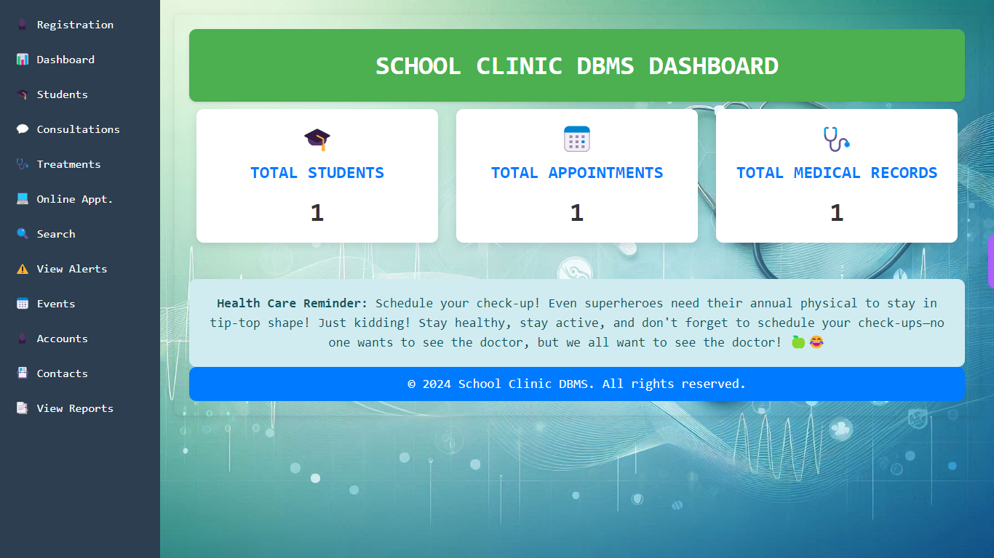
10. Other Feature
10.1 Dashboard

Slide 26
10. Other Feature
10.2 Student Dashboard

Slide 27
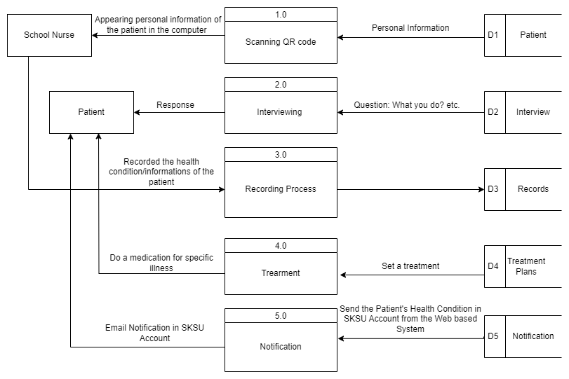
LOGICAL DATA FLOW DIAGRAM

Slide 28
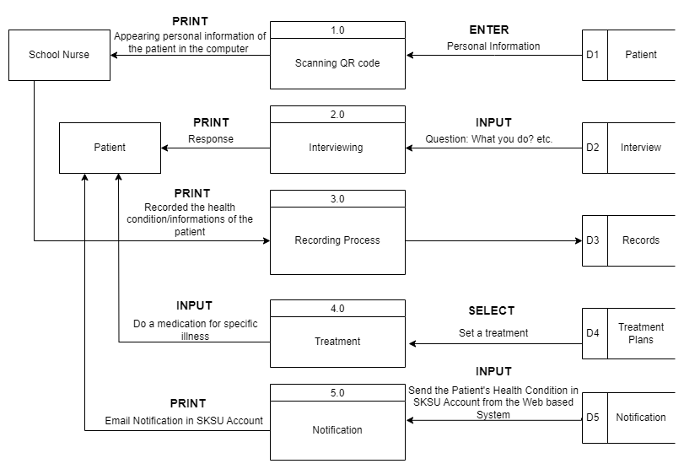
PHYSICAL DATA FLOW DIAGRAM

Slide 29
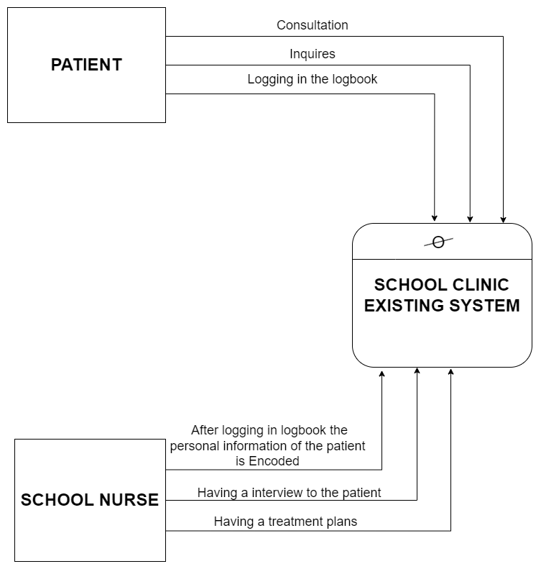
CONTEXT DIAGRAM OF THE EXISTING SYSTEM

Slide 30
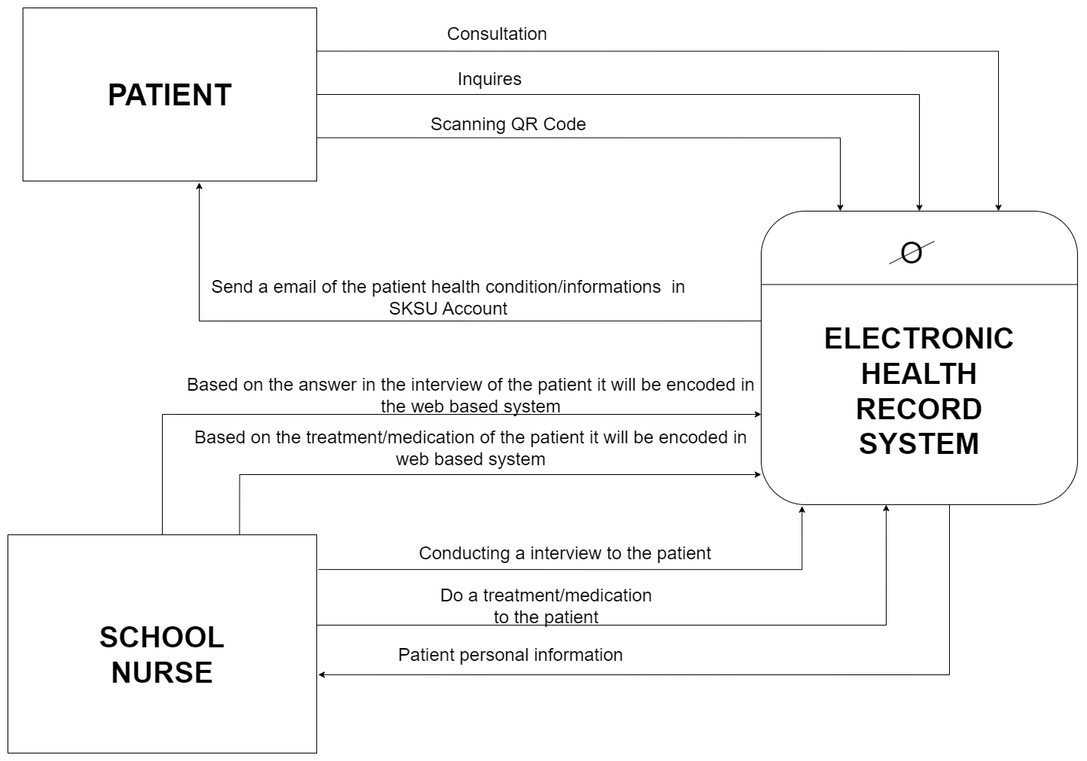
CONTEXT DIAGRAM OF THE SYSTEM

